Slide 1

Notes:
Reload codespace
Update settings.json.
Uncheck VS Code tabs except for Terminal
Hide Activity Bar
Hide Explorer
Remove comments from any pre-made code

Slide 2
This is CS50
Visit cs50.ly/screen to view projector on your laptop and ask questions via chat.
Today's snack, rice krispie treats!
Like to attend CS50 Lunch this Fri 11/10 at 1:15pm? RSVP at cs50.ly/lunch!
Do say hi or ask questions (or ask for stress ball 🔴) during break or after class!

Slide 3


Slide 5

Notes:
Shoshana Promer, Yale ’26

Slide 6
internet

Slide 7
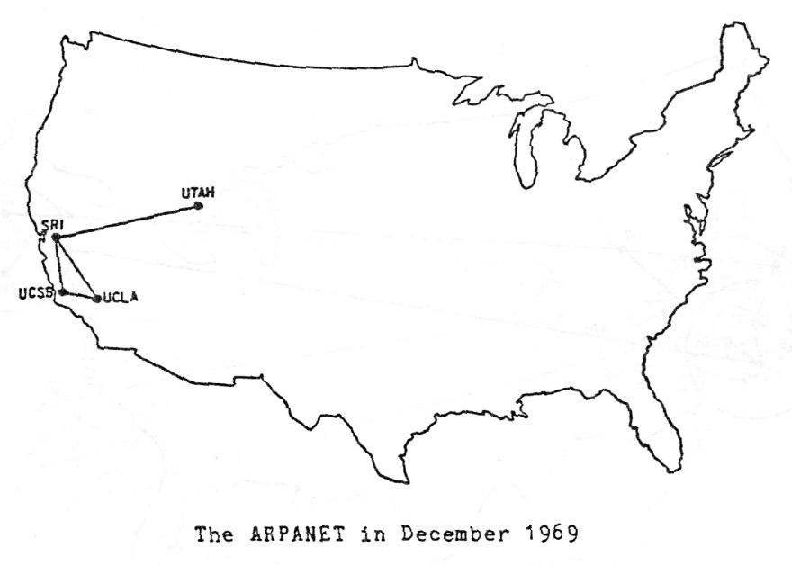
Notes:
http://mercury.lcs.mit.edu/~jnc/tech/arpageo.html

Slide 8
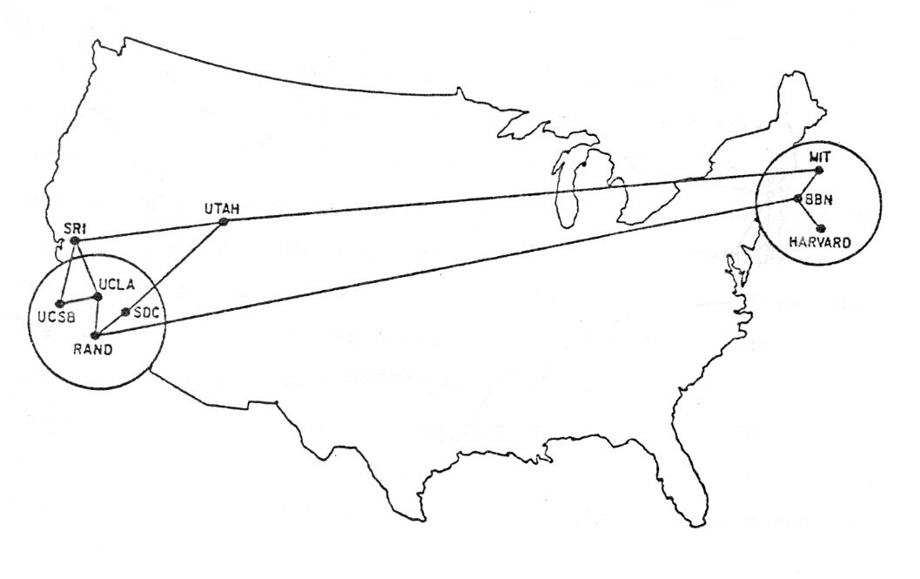
Notes:
http://mercury.lcs.mit.edu/~jnc/tech/arpageo.html

Slide 9
routers

Slide 10
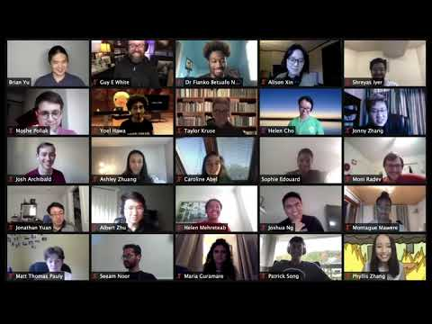
Notes:
https://www.youtube.com/watch?v=cUJlRNRguAM

Slide 11
TCP/IP

Slide 12
IP

Slide 13
#.#.#.#

Slide 14
0 1 2 3
0 1 2 3 4 5 6 7 8 9 0 1 2 3 4 5 6 7 8 9 0 1 2 3 4 5 6 7 8 9 0 1
+-+-+-+-+-+-+-+-+-+-+-+-+-+-+-+-+-+-+-+-+-+-+-+-+-+-+-+-+-+-+-+-+
|Version| IHL |Type of Service| Total Length |
+-+-+-+-+-+-+-+-+-+-+-+-+-+-+-+-+-+-+-+-+-+-+-+-+-+-+-+-+-+-+-+-+
| Identification |Flags| Fragment Offset |
+-+-+-+-+-+-+-+-+-+-+-+-+-+-+-+-+-+-+-+-+-+-+-+-+-+-+-+-+-+-+-+-+
| Time to Live | Protocol | Header Checksum |
+-+-+-+-+-+-+-+-+-+-+-+-+-+-+-+-+-+-+-+-+-+-+-+-+-+-+-+-+-+-+-+-+
| Source Address |
+-+-+-+-+-+-+-+-+-+-+-+-+-+-+-+-+-+-+-+-+-+-+-+-+-+-+-+-+-+-+-+-+
| Destination Address |
+-+-+-+-+-+-+-+-+-+-+-+-+-+-+-+-+-+-+-+-+-+-+-+-+-+-+-+-+-+-+-+-+
| Options | Padding |
+-+-+-+-+-+-+-+-+-+-+-+-+-+-+-+-+-+-+-+-+-+-+-+-+-+-+-+-+-+-+-+-+
Example Internet Datagram Header
Notes:
https://datatracker.ietf.org/doc/html/rfc791

Slide 15
TCP

Slide 16
ports

Slide 17
80 HTTP
443 HTTPS
...

Slide 18
0 1 2 3
0 1 2 3 4 5 6 7 8 9 0 1 2 3 4 5 6 7 8 9 0 1 2 3 4 5 6 7 8 9 0 1
+-+-+-+-+-+-+-+-+-+-+-+-+-+-+-+-+-+-+-+-+-+-+-+-+-+-+-+-+-+-+-+-+
| Source Port | Destination Port |
+-+-+-+-+-+-+-+-+-+-+-+-+-+-+-+-+-+-+-+-+-+-+-+-+-+-+-+-+-+-+-+-+
| Sequence Number |
+-+-+-+-+-+-+-+-+-+-+-+-+-+-+-+-+-+-+-+-+-+-+-+-+-+-+-+-+-+-+-+-+
| Acknowledgment Number |
+-+-+-+-+-+-+-+-+-+-+-+-+-+-+-+-+-+-+-+-+-+-+-+-+-+-+-+-+-+-+-+-+
| Data | |U|A|P|R|S|F| |
| Offset| Reserved |R|C|S|S|Y|I| Window |
| | |G|K|H|T|N|N| |
+-+-+-+-+-+-+-+-+-+-+-+-+-+-+-+-+-+-+-+-+-+-+-+-+-+-+-+-+-+-+-+-+
| Checksum | Urgent Pointer |
+-+-+-+-+-+-+-+-+-+-+-+-+-+-+-+-+-+-+-+-+-+-+-+-+-+-+-+-+-+-+-+-+
| Options | Padding |
+-+-+-+-+-+-+-+-+-+-+-+-+-+-+-+-+-+-+-+-+-+-+-+-+-+-+-+-+-+-+-+-+
| data |
+-+-+-+-+-+-+-+-+-+-+-+-+-+-+-+-+-+-+-+-+-+-+-+-+-+-+-+-+-+-+-+-+
TCP Header Format
Notes:
https://www.ietf.org/rfc/rfc793.txt

Slide 19
DNS

Slide 20
Fully Qualified Domain Name | IP Address

Slide 21
Fully Qualified Domain Name | IP Address

Slide 22
DHCP

Slide 23
HTTP

Slide 24
HTTPS

Slide 25
https://www.example.com

Slide 26
https://www.example.com/

Slide 27
https://www.example.com/path

Slide 28
https://www.example.com/file.html

Slide 29
https://www.example.com/folder/

Slide 30
https://www.example.com/folder/file.html

Slide 31
https://www.example.com/folder/file.html

Slide 32
https://www.example.com/folder/file.html

Slide 33
https://www.example.com/folder/file.html

Slide 34
https://www.example.com/folder/file.html

Slide 35
https://www.example.com/folder/file.html

Slide 36
GET
POST
...

Slide 37
GET / HTTP/2
Host: www.harvard.edu
...
Notes:
curl -I https://www.harvard.edu/

Slide 38
HTTP/2 200
Content-Type: text/html
...

Slide 39
developer tools

Slide 40
HTTP/2 301
Location: https://www.harvard.edu/
…

Slide 41
GET / HTTP/2
Host: harvard.edu
...
Notes:
curl -I https://harvard.edu/

Slide 42
HTTP/2 404
Content-Type: text/html
...

Slide 43
200 OK 301 Moved Permanently 302 Found 304 Not Modified 307 Temporary Redirect 401 Unauthorized 403 Forbidden 404 Not Found 418 I'm a Teapot 500 Internal Server Error 503 Service Unavailable ...

Slide 44
GET / HTTP/1.1
Host: safetyschool.org
...
Notes:
curl -I http://safetyschool.org/

Slide 45
HTML

Slide 46
tags
attributes

Slide 47
<!DOCTYPE html>
<html lang="en">
<head>
<title>
hello, title
</title>
</head>
<body>
hello, body
</body>
</html>
Notes:
hello0.html

Slide 48
http-server

Slide 49
<!DOCTYPE html>
<html lang="en">
<head>
<title>
hello, title
</title>
</head>
<body>
hello, body
</body>
</html>
Notes:
faster

Slide 50
<!DOCTYPE html>
<html lang="en">
<head>
<title>
hello, title
</title>
</head>
<body>
hello, body
</body>
</html>

Slide 51
<!DOCTYPE html>
<html lang="en">
<head>
<title>
hello, title
</title>
</head>
<body>
hello, body
</body>
</html>

Slide 52
<!DOCTYPE html>
<html lang="en">
<head>
<title>
hello, title
</title>
</head>
<body>
hello, body
</body>
</html>

Slide 53
<!DOCTYPE html>
<html lang="en">
<head>
<title>
hello, title
</title>
</head>
<body>
hello, body
</body>
</html>

Slide 54
<!DOCTYPE html>
<html lang="en">
<head>
<title>
hello, title
</title>
</head>
<body>
hello, body
</body>
</html>

Slide 55
<!DOCTYPE html>
<html lang="en">
<head>
<title>
hello, title
</title>
</head>
<body>
hello, body
</body>
</html>

Slide 56
<!DOCTYPE html>
<html lang="en">
<head>
<title>
hello, title
</title>
</head>
<body>
hello, body
</body>
</html>

Slide 57
<!DOCTYPE html>
<html lang="en">
<head>
<title>
hello, title
</title>
</head>
<body>
hello, body
</body>
</html>

Slide 58
<!DOCTYPE html>
<html lang="en">
<head>
<title>
hello, title
</title>
</head>
<body>
hello, body
</body>
</html>

Slide 59
<!DOCTYPE html>
<html lang="en">
<head>
<title>
hello, title
</title>
</head>
<body>
hello, body
</body>
</html>

Slide 60
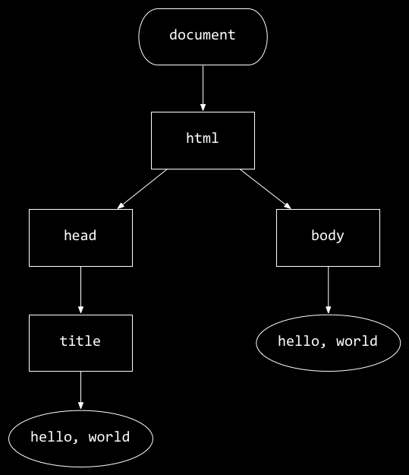
<!DOCTYPE html>
<html lang="en">
<head>
<title>
hello, title
</title>
</head>
<body>
hello, body
</body>
</html>
hello, body
hello, title

Slide 61
https://www.example.com

Slide 62
https://www.example.com/path?key=value

Slide 63
https://www.example.com/path?key=value&key=value
Notes:
https://www.google.com/search?q=cats

Slide 64
break

Slide 65
Notes:
Shoshana Promer, Yale ’26

Slide 66
Notes:
Shoshana Promer, Yale ’26
Jude, Darwin

Slide 67
Notes:
Shoshana Promer, Yale ’26
Jude, Darwin

Slide 68
Notes:
Shoshana Promer, Yale ’26

Slide 69
Notes:
Shoshana Promer, Yale ’26
Jude, Darwin

Slide 70
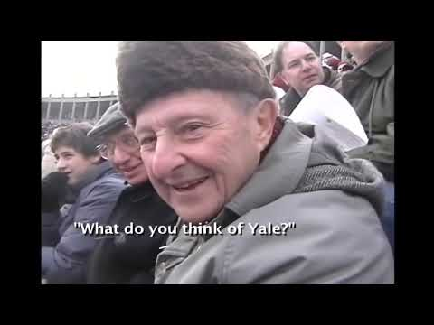
https://www.youtube.com/watch?v=jjR0nsb9Kmw
Notes:
https://www.youtube.com/watch?v=jjR0nsb9Kmw

Slide 71
regular expressions

Slide 72
regexes

Slide 73
developer.mozilla.org/en-US/docs/Web/JavaScript/Guide/Regular_expressions

Slide 74
. any single character (except line terminators)
* zero or more times
+ one or more times
? 0 or 1 time
{n} n occurrences
{n,m} at least n occurrences, at most m occurrences
…
Notes:
https://developer.mozilla.org/en-US/docs/Web/JavaScript/Guide/Regular_expressions

Slide 75
[0123456789] any one of the enclosed characters
[0-9] any one of the range of characters
\d any digit
\D any character that is not a digit
…
Notes:
https://developer.mozilla.org/en-US/docs/Web/JavaScript/Guide/Regular_expressions

Slide 76
^[a-zA-Z0-9.!#$%&'*+\/=?^_`{|}~-]+@[a-zA-Z0-9](?:[a-zA-Z0-9-]{0,61}[a-zA-Z0-9])?(?:\.[a-zA-Z0-9](?:[a-zA-Z0-9-]{0,61}[a-zA-Z0-9])?)*$
Notes:
https://html.spec.whatwg.org/multipage/input.html#valid-e-mail-address

Slide 77
developer tools

Slide 78
validator.w3.org

Slide 79
CSS

Slide 80
properties

Slide 81
type selector
class selector
ID selector
attribute selector
...
Notes:
https://developer.mozilla.org/en-US/docs/Web/CSS/CSS_Selectors

Slide 82
<!DOCTYPE html>
<html lang="en">
<head>
<title>
hello, title
</title>
</head>
<body>
hello, body
</body>
</html>

Slide 83
<!DOCTYPE html>
<html lang="en">
<head>
<style>
</style>
<title>
hello, title
</title>
</head>
<body>
hello, body
</body>
</html>

Slide 84
<!DOCTYPE html>
<html lang="en">
<head>
<link href="styles.css" rel="stylesheet">
<title>
hello, title
</title>
</head>
<body>
hello, body
</body>
</html>
Notes:
CSS examples

Slide 85
frameworks
Notes:
https://getbootstrap.com/

Slide 86
Bootstrap

Slide 87
getbootstrap.com

Slide 88
developer tools

Slide 89
JavaScript

Slide 90
conditionals

Slide 91
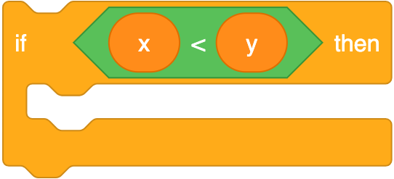
if (x < y) {
}
Notes:
https://scratchblocks.github.io/#?style=scratch3&script=if%20%3C(x)%20%3C%20(y)%3E%20then

Slide 92
if (x < y) {
}

Slide 93
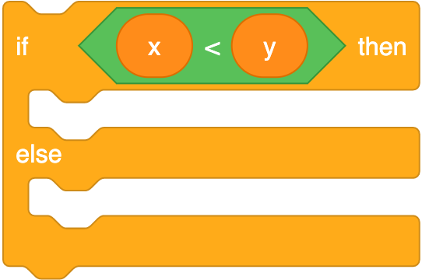
if (x < y) {
}
else
{
}
Notes:
https://scratchblocks.github.io/#?style=scratch3&script=if%20%3C(x)%20%3C%20(y)%3E%20then%0A%0Aelse

Slide 94
if (x < y) {
}
else
{
}

Slide 95
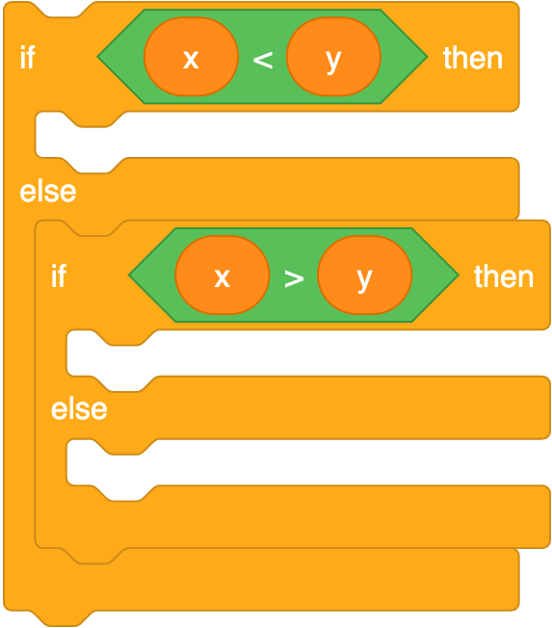
if (x < y) {
}
else if (x > y)
{
}
else
{
}
Notes:
https://scratchblocks.github.io/#?style=scratch3&script=if%20%3C(x)%20%3C%20(y)%3E%20then%0A%0Aelse%0A%0Aif%20%3C(x)%20%3E%20(y)%3E%20then%0A%0Aelse

Slide 96
if (x < y) {
}
else if (x > y)
{
}
else
{
}

Slide 97
variables

Slide 98
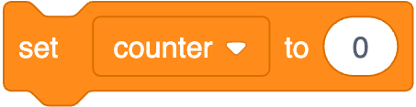
let counter = 0;
Notes:
https://scratchblocks.github.io/#?style=scratch3&script=set%20%5Bcounter%20v%5D%20to%20%5B0%5D

Slide 99
let counter = 0;

Slide 100

counter = counter + 1;
Notes:
https://scratchblocks.github.io/#?style=scratch3&script=change%20%5Bcounter%20v%5D%20by%20%5B1%5D

Slide 101
counter = counter + 1;

Slide 102
counter += 1;

Slide 103
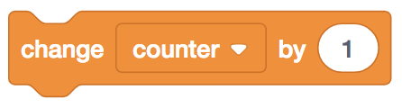
counter++;

Slide 104
loops

Slide 105
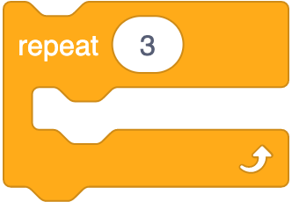
for (let i = 0; i < 3; i++)
{
}
Notes:
https://scratchblocks.github.io/#?style=scratch3&script=repeat%20%5B3%5D

Slide 106
for (let i = 0; i < 3; i++)
{
}

Slide 107

while (true)
{
}
Notes:
https://scratchblocks.github.io/#?style=scratch3&script=forever

Slide 108
while (true)
{
}

Slide 109
<!DOCTYPE html>
<html lang="en">
<head>
<title>
hello, title
</title>
</head>
<body>
hello, body
</body>
</html>
hello, body
hello, title

Slide 110
<!DOCTYPE html>
<html lang="en">
<head>
<title>
hello, title
</title>
</head>
<body>
hello, body
</body>
</html>

Slide 111
<!DOCTYPE html>
<html lang="en">
<head>
<script>
</script>
<title>
hello, title
</title>
</head>
<body>
hello, body
</body>
</html>

Slide 112
<!DOCTYPE html>
<html lang="en">
<head>
<script src="scripts.js"></script>
<title>
hello, title
</title>
</head>
<body>
hello, body
</body>
</html>

Slide 113
<!DOCTYPE html>
<html lang="en">
<head>
<title>
hello, title
</title>
</head>
<body>
hello, body
<script>
</script>
</body>
</html>

Slide 114
<!DOCTYPE html>
<html lang="en">
<head>
<title>
hello, title
</title>
</head>
<body>
hello, body
<script src="scripts.js"></script>
</body>
</html>

Slide 115
blur change click drag focus keyup load mousedown mouseover mouseup submit touchmove unload ...
Notes:
JavaScript examples

Slide 116
Bootstrap Table

Slide 117
bootstrap-table.com

Slide 119
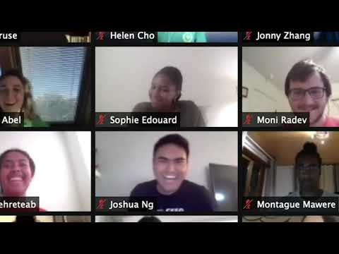
Notes:
https://www.youtube.com/watch?v=mofAEZ6fWLc

Slide 120
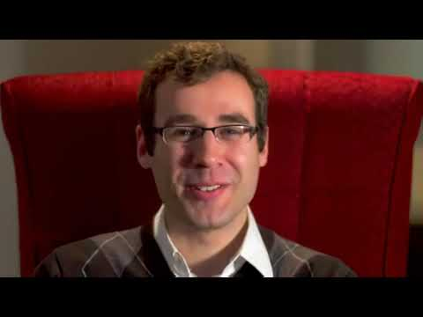
Notes:
https://www.youtube.com/watch?v=kOZohorpS3c

